Slide 1
Exploring the effects of
Multiplying and Dividing
by powers of 10

Slide 2
1000 | 2000 | 3000 | 4000 | 5000 | 6000 | 7000 | 8000 | 9000
100 | 200 | 300 | 400 | 500 | 600 | 700 | 800 | 900
10 | 20 | 30 | 40 | 50 | 60 | 70 | 80 | 90
1 | 2 | 3 | 4 | 5 | 6 | 7 | 8 | 9
0.1 | 0.2 | 0.3 | 0.4 | 0.5 | 0.6 | 0.7 | 0.8 | 0.9
0.01 | 0.02 | 0.03 | 0.04 | 0.05 | 0.06 | 0.07 | 0.08 | 0.09
0.001 | 0.002 | 0.003 | 0.004 | 0.005 | 0.006 | 0.007 | 0.008 | 0.009

Slide 3
1000 | 2000 | 3000 | 4000 | 5000 | 6000 | 7000 | 8000 | 9000
100 | 200 | 300 | 400 | 500 | 600 | 700 | 800 | 900
10 | 20 | 30 | 40 | 50 | 60 | 70 | 80 | 90
1 | 2 | 3 | 4 | 5 | 6 | 7 | 8 | 9
0.1 | 0.2 | 0.3 | 0.4 | 0.5 | 0.6 | 0.7 | 0.8 | 0.9
0.01 | 0.02 | 0.03 | 0.04 | 0.05 | 0.06 | 0.07 | 0.08 | 0.09
0.001 | 0.002 | 0.003 | 0.004 | 0.005 | 0.006 | 0.007 | 0.008 | 0.009
How can you get from 4 to 80?

Slide 4
1000 | 2000 | 3000 | 4000 | 5000 | 6000 | 7000 | 8000 | 9000
100 | 200 | 300 | 400 | 500 | 600 | 700 | 800 | 900
10 | 20 | 30 | 40 | 50 | 60 | 70 | 80 | 90
1 | 2 | 3 | 4 | 5 | 6 | 7 | 8 | 9
0.1 | 0.2 | 0.3 | 0.4 | 0.5 | 0.6 | 0.7 | 0.8 | 0.9
0.01 | 0.02 | 0.03 | 0.04 | 0.05 | 0.06 | 0.07 | 0.08 | 0.09
0.001 | 0.002 | 0.003 | 0.004 | 0.005 | 0.006 | 0.007 | 0.008 | 0.009
We can do 4 x 100 = 400 x 2 = 800 ÷ 10 = 80
write down some other methods

Slide 5
1000 | 2000 | 3000 | 4000 | 5000 | 6000 | 7000 | 8000 | 9000
100 | 200 | 300 | 400 | 500 | 600 | 700 | 800 | 900
10 | 20 | 30 | 40 | 50 | 60 | 70 | 80 | 90
1 | 2 | 3 | 4 | 5 | 6 | 7 | 8 | 9
0.1 | 0.2 | 0.3 | 0.4 | 0.5 | 0.6 | 0.7 | 0.8 | 0.9
0.01 | 0.02 | 0.03 | 0.04 | 0.05 | 0.06 | 0.07 | 0.08 | 0.09
0.001 | 0.002 | 0.003 | 0.004 | 0.005 | 0.006 | 0.007 | 0.008 | 0.009
How can you get from 6 to 200?

Slide 6
1000 | 2000 | 3000 | 4000 | 5000 | 6000 | 7000 | 8000 | 9000
100 | 200 | 300 | 400 | 500 | 600 | 700 | 800 | 900
10 | 20 | 30 | 40 | 50 | 60 | 70 | 80 | 90
1 | 2 | 3 | 4 | 5 | 6 | 7 | 8 | 9
0.1 | 0.2 | 0.3 | 0.4 | 0.5 | 0.6 | 0.7 | 0.8 | 0.9
0.01 | 0.02 | 0.03 | 0.04 | 0.05 | 0.06 | 0.07 | 0.08 | 0.09
0.001 | 0.002 | 0.003 | 0.004 | 0.005 | 0.006 | 0.007 | 0.008 | 0.009
How can you get from 400 to 0.05?

Slide 7
1000 | 2000 | 3000 | 4000 | 5000 | 6000 | 7000 | 8000 | 9000
100 | 200 | 300 | 400 | 500 | 600 | 700 | 800 | 900
10 | 20 | 30 | 40 | 50 | 60 | 70 | 80 | 90
1 | 2 | 3 | 4 | 5 | 6 | 7 | 8 | 9
0.1 | 0.2 | 0.3 | 0.4 | 0.5 | 0.6 | 0.7 | 0.8 | 0.9
0.01 | 0.02 | 0.03 | 0.04 | 0.05 | 0.06 | 0.07 | 0.08 | 0.09
0.001 | 0.002 | 0.003 | 0.004 | 0.005 | 0.006 | 0.007 | 0.008 | 0.009
Ask other similar questions.

Slide 8
Developing Problems
Hand out 4 pieces of coloured A6 paper to a group of 4 pupils and ask them to each write down one of the numbers from the first column
100
0.1
1000
10
0.01
1

Slide 9
Developing Problems
Hand out 4 pieces of coloured A6 paper (another colour) to a group of 4 pupils and ask them to each write down one of the numbers from the second column
200
0.2
2000
20
0.02
2

Slide 10
Developing Problems
Continue this process until all the pupils have a piece of coloured paper with one of the numbers from the grid written on it.
500
0.2
4000
30
0.07
9

Slide 11
Green cards to the front in order of size
How do we move from left to right from pupil to pupil?
Arrange the pupils by height – how do we move across now?
How do we move back along from right to left?
Pick a blue and a green card – how do you get from one
number to the other
Pick a person - say 60 who has this number x 10?
Who has this number divided by 6 etc…

Slide 12
Calculations
Write some of the calculations we have been discussing on pieces of paper and collect them in.
Read out the calculation and see who has the number on their card (if anyone)
0.2 x 10
6 ÷ 100
90 x 100
700 ÷ 10³
0.07 x 10⁵

Slide 13
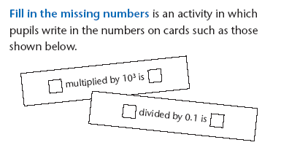
Developing Problems
Fill in the missing numbers

Slide 14
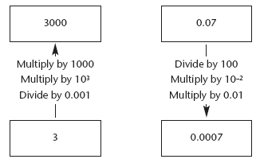
Developing Problems
Fill in the missing operations

Slide 15
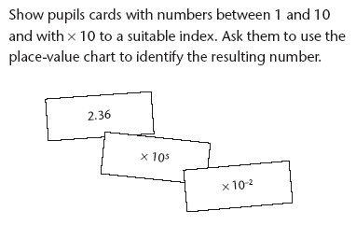
Developing Problems
Extend to involve more than 1 significant figure

